Slide 1
Logic Gates
Course Code: CSC 1101
Course Title: Introduction to Computer Studies
Dept. of Computer Science
Faculty of Science and Technology
Lecturer No: | 09 | Week No: | 09 | Semester:
Lecturer: | Name & email

Slide 2
Lecture Outline
Understanding Logic Gate and the use of these.

Slide 3
Specific Objectives
Logic gates
Logic circuits and Boolean expressions
Combinational circuits and design

Slide 4
Logic Gate
Logic gates are electronic circuits that operate on one or more input signals to produce standard output signal
Are the building blocks of all the circuits in a computer
Some of the most basic and useful logic gates are AND, OR, NOT, NAND and NOR gates

Slide 5
AND Gate
Physical realization of logical multiplication (AND) operation.
Generates output signal of 1 only if all input signals are also 1

Slide 6
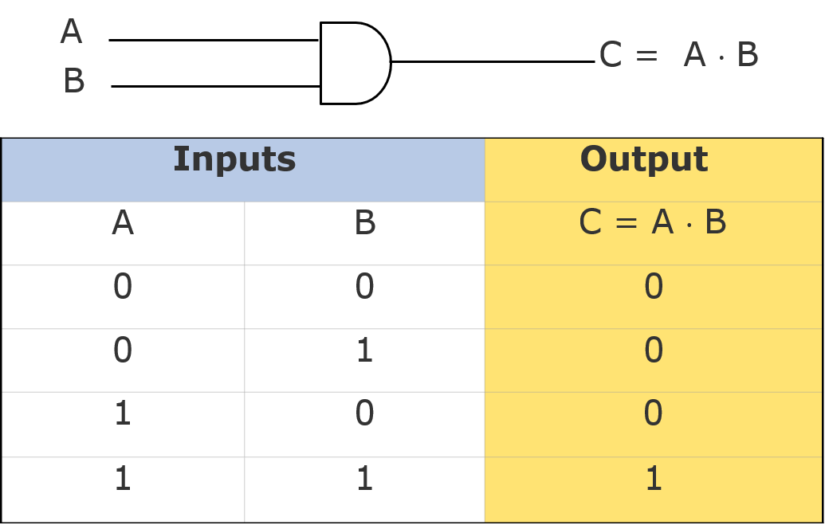
AND Gate (Block Diagram Symbol and Truth Table)

Slide 7
OR Gate
Physical realization of logical addition (OR) operation
Generates an output signal of 1 if at least one of the input signals is also 1

Slide 8
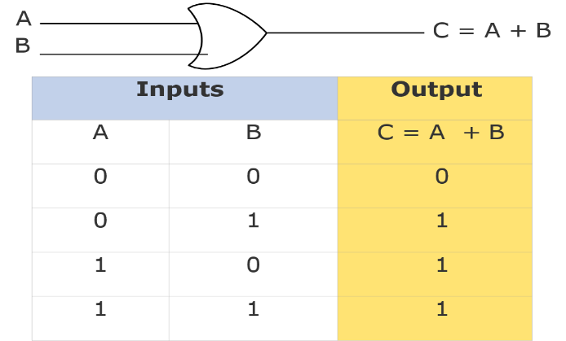
OR Gate (Block Diagram Symbol and Truth Table)

Slide 9
NOT Gate
Physical realization of complementation operation
Generates an output signal, which is the reverse of the input signal

Slide 10
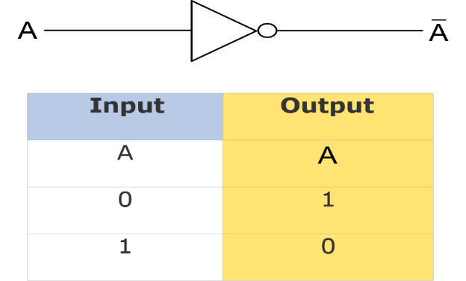
NOT Gate (Block Diagram Symbol and Truth Table)

Slide 11
NAND Gate
Complemented AND gate
Generates an output signal of:
1 if any one of the inputs is a 0
0 when all the inputs are 1

Slide 12
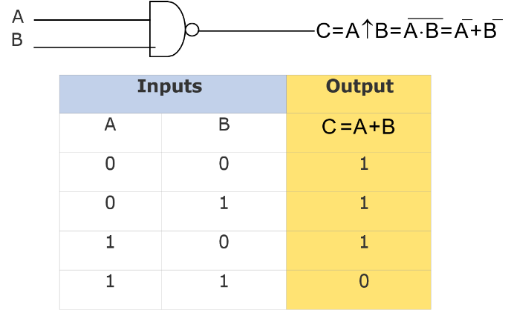
NAND Gate (Block Diagram Symbol and Truth Table)

Slide 13
NOR Gate
Complemented OR gate
Generates an output signal of:
1 only when all inputs are 0
0 if any one of inputs is a 1

Slide 14
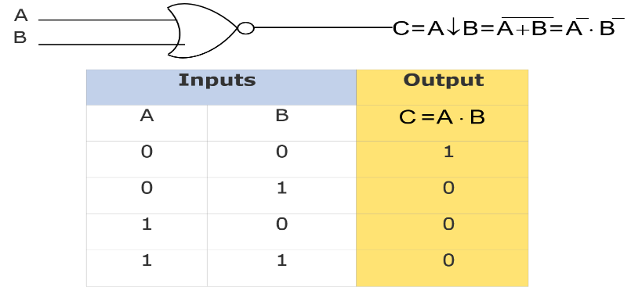
NOR Gate (Block Diagram Symbol and Truth Table)

Slide 15
Logic Circuits
When logic gates are interconnected to form a gating / logic network, it is known as a combinational logic circuit
The Boolean algebra expression for a given logic circuit can be derived by systematically progressing from input to output on the gates
The three logic gates (AND, OR, and NOT) are logically complete because any Boolean expression can be realized as a logic circuit using only these three gates

Slide 16
Finding Boolean Expression of a Logic Circuit(Example 1)
A
A
NOT
D= A⋅(B + C)
B C
B + C
AND
OR

Slide 17
Finding Boolean Expression of a Logic Circuit(Example 2)
OR
A B
A + B
C=(A +B)⋅(A⋅B)
A ⋅B
A⋅B
AND
AND
NOT

Slide 18
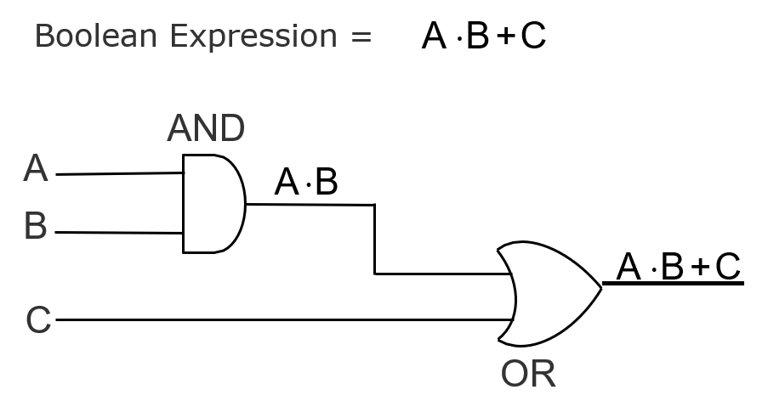
Constructing a Logic Circuit from a Boolean Expression (Example 1)

Slide 19
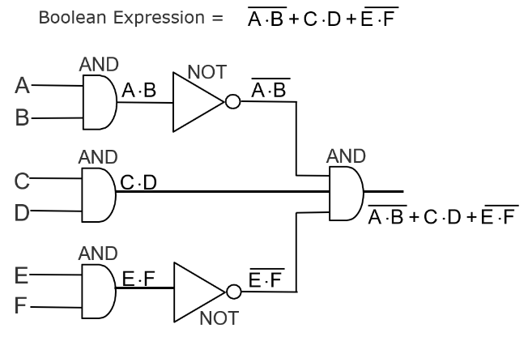
Constructing a Logic Circuit from a Boolean Expression (Example 2)

Slide 20
Universal NAND Gate
Nand gate is an universal gate, I is alone sufficient to implement
any Boolean expression
To understand this, consider:
Basic logic gates (AND, OR, and NOT) are logically complete
Sufficient to show that AND, OR, and NOT gates can be implemented with NAND gates

Slide 21
Implementation of NOT, AND and OR Gates by NAND Gates
A ⋅ A = A + A = A
A
(a) NOT gate implementation.
A ⋅B
A B
A ⋅ B = A ⋅B
(b) AND gate implementation.
(Continued on next slide)

Slide 22
Implementation of NOT, AND and OR Gates by NAND Gates (Continued from previous slide..)
and OR Gates by
A ⋅ A =A
A
A ⋅B = A + B = A + B
B ⋅B =B
B
(c) OR gate implementation.

Slide 23
Method of Implementing a Boolean Expression with Only NAND Gates
Step 1: From the given algebraic expression, draw the logic diagram with AND, OR, and NOT gates. Assume that
both the normal available
(A) and complement (_{A})
inputs are
Step 2:
Draw a second logic diagram with the equivalent NAND logic substituted for each AND, OR, and NOT gate
Step
3: Remove diagram
all pairs of cascaded inverters from the as double inversion does not perform any
logical
single external inputs
function. Also remove inverters
connected to
the
and complement
corresponding input variable

Slide 24
Implementing a Boolean Expression with Only NAND Gates (Example)
Boolean Expression =
A ⋅ B + C ⋅(A + B ⋅D )
A
B
A⋅B
A ⋅ B + C ⋅(A + B ⋅D )
B D A
C
B⋅D
A +B⋅D
C⋅(A +B⋅D)
(a) Step 1: AND/OR implementation
(Continued on next slide)

Slide 25
Implementing a Boolean Expression with Only NAND Gates (Example) (Continued from previous slide..)
AND
OR
A B
A⋅B
1
5
AND
B⋅D
OR
B D
2
A+B⋅D
A ⋅B + C⋅(A+B⋅D)
3
A
AND
C
4
C⋅(A+B⋅D)
(b) Step 2:
Substituting equivalent NAND functions
(Continued on next slide)

Slide 26
Implementing a Boolean Expression with Only NAND Gates (Example) (Continued from previous slide..)
(
A
1
B
B D
A ⋅B + C⋅(A +B⋅D)
5
2
A
C
3
4
(c) Step 3:
NAND implementation.

Slide 27
Universal NOR Gate
NOR gate is an universal gate, it is alone sufficient to implement any Boolean expression
To understand this, consider:
Basic logic gates (AND, OR, and NOT) are logically complete
Sufficient to show that AND, OR, and NOT gates can be implemented with NOR gates

Slide 28
Implementation of NOT, OR and AND Gates by NOR Gates
A
A + A = A ⋅ A = A
(a) NOT gate implementation.
A B
A + B
A + B = A + B
(b) OR gate implementation.
(Continued on next slide)

Slide 29
Implementation of NOT, OR and AND Gates by NOR Gates (Continued from previous slide..)
A + A =A
A
A + B = A ⋅B = A ⋅B
B + B =B
B
(c) AND gate implementation.

Slide 30
Method of Implementing a Boolean Expression with Only NOR Gates
Step 1: For the given algebraic expression, draw the logic
diagram with AND, OR, and NOT gates. Assume that
both the normal _{(A)}
available
(A)
and complement
inputs are
Step 2:
Draw a second logic diagram with equivalent NOR logic substituted for each AND, OR, and NOT gate
Step 3:
Remove all parts of cascaded inverters from the diagram as double inversion does not perform any
logical function. Also remove inverters single external inputs and
connected to
the
complement
corresponding input variable

Slide 31
Implementing a Boolean Expression with Only NOR Gates (Examples)(Continued from previous slide..)
Boolean Expression A ⋅B + C⋅(A +B⋅D)
=
A⋅B
A
B
A ⋅B + C⋅(A +B⋅D)
B D A
C
B⋅D
A +B⋅D
C⋅(A +B⋅D)
(a) Step 1: AND/OR implementation.
(Continued on next slide)

Slide 32
A
AND
B
OR
(
)
A ⋅ B + C⋅ A +B⋅D
5
6
AND
B
B⋅D
2
D
OR
AN
D
A
3
4
C⋅ (A +B⋅D)
C
A +B⋅D
Substituting equivalent NOR functions.
(b) Step 2:
(Continued on next slide)

Slide 33
Implementing a Boolean Expression with Only NOR Gates (Examples)(Continued from previous slide..)
A B
1
A ⋅B + C⋅(A +B⋅D)
5
6
B
D
A C
2
3
4
(c) Step 3:
NOR implementation.

Slide 34
Exclusive-OR Function
A ⊕ B = A ⋅ B + A ⋅ B
A B
C = A ⊕B = A ⋅B+ A ⋅B
A ⊕
C = A ⊕B = A ⋅B+ A ⋅B
B
Also, (A ⊕B)⊕ C = A ⊕ (B ⊕ C) = A ⊕B ⊕ C
(Continued on next slide)

Slide 35
Exclusive-OR Function (Truth Table)
(Continued from previous slide..)
Inputs |  | Output
A | B | C = A ⊕B
0 | 0 | 0
0 | 1 | 1
1 | 0 | 1
1 | 1 | 0

Slide 36
Equivalence Function with Block Diagram Symbol
A © B = A ⋅ B+ A ⋅ B
A B
C = A © B = A ⋅B+ A ⋅B
Also, (A © B) © = A © (B © C) = A © B © C
(Continued on next slide)

Slide 37
Equivalence Function (Truth Table)
Inputs |  | Output
A | B | C = A © B
0 | 0 | 1
0 | 1 | 0
1 | 0 | 0
1 | 1 | 1

Slide 38
Steps in Designing Combinational Circuits
State the given problem completely and exactly
Interpret the problem and determine the available input variables and required output variables
Assign a letter symbol to each input and output variables
Design the truth table that defines the required relations between inputs and outputs
Obtain the simplified Boolean function for each output
Draw the logic circuit diagram to implement the Boolean function

Slide 39
Designing a Combinational Circuit Example 1 – Half-Adder Design
Inputs |  | Outputs
A | B | C | S
0 | 0 | 0 | 0
0 | 1 | 0 | 1
1 | 0 | 0 | 1
1 | 1 | 1 | 0
S = A⋅B+ A⋅B C = A⋅B
Boolean functions for the two outputs.

Slide 40
Designing a Combinational Circuit Example 1 – Half-Adder Design(Continued from previous slide..)
A
A
A⋅B
S = A⋅B+ A⋅B
B
B
A⋅B
A B
C = A⋅B
Logic circuit diagram to implement the Boolean functions

Slide 41
Designing a Combinational Circuit Example 2 – Full-Adder Design
Inputs |  |  | Outputs
A | B | D | C | S
0 | 0 | 0 | 0 | 0
0 | 0 | 1 | 0 | 1
0 | 1 | 0 | 0 | 1
0 | 1 | 1 | 1 | 0
1 | 0 | 0 | 0 | 1
1 | 0 | 1 | 1 | 0
1 | 1 | 0 | 1 | 0
1 | 1 | 1 | 1 | 1
Truth table for a full adder
(Continued on next slide)

Slide 42
Designing a Combinational Circuit Example 2 – Full-Adder Design(Continued from previous slide..)
Boolean functions for the two outputs:
S = A⋅B⋅D+ A⋅B⋅D+ A⋅B⋅D+ A⋅B⋅D C = A⋅B⋅D+ A⋅B⋅D+ A⋅B⋅D+ A⋅B⋅D
= A⋅B+ A⋅D+B⋅D
(when simplified)
(Continued on next slide)

Slide 43
Designing a Combinational Circuit Example 2 – Full-Adder Design(Continued from previous slide..)
A B
A ⋅B ⋅D
D
A
A ⋅B ⋅D
B
D
S
A
B D
A ⋅B ⋅D
A B
A ⋅B ⋅D
D
(a) Logic circuit diagram for sums
(Continued on next slide)

Slide 44
Designing a Combinational Circuit Example 2 – Full-Adder Design(Continued from previous slide..)
A B
A ⋅ B
A D
A ⋅ D
C
B D
B ⋅ D
(b) Logic circuit diagram for carry

Slide 45
Key Words/Phrases
Absorption law
AND gate
Associative law
Boolean algebra
Boolean expression
Boolean functions
Boolean identities
Canonical forms for Boolean functions
Combination logic
circuits
Cumulative law
Complement of a function
Complementation
De Morgan’s law
Distributive law
Dual identities
Equivalence function
Exclusive-OR function
Exhaustive enumeration method
Half-adder
Idempotent law
Involution law
Literal
Logic circuits
Logic gates
Logical addition
Logical multiplication
Maxterms
Minimization of Boolean functions
Minterms
NAND gate
NOT gate
Operator precedence
OR gate
Parallel Binary Adder
Perfect induction method
Postulates of Boolean algebra
Principle of duality
Product-of-Sums expression
Standard forms
Sum-of Products expression
Truth table
Universal NAND gate
Universal NOR gate

Slide 46
References
Computer Fundamentals: Pradeep K. Sinha & Priti Sinha

Slide 47
Thank you

